Slide 1
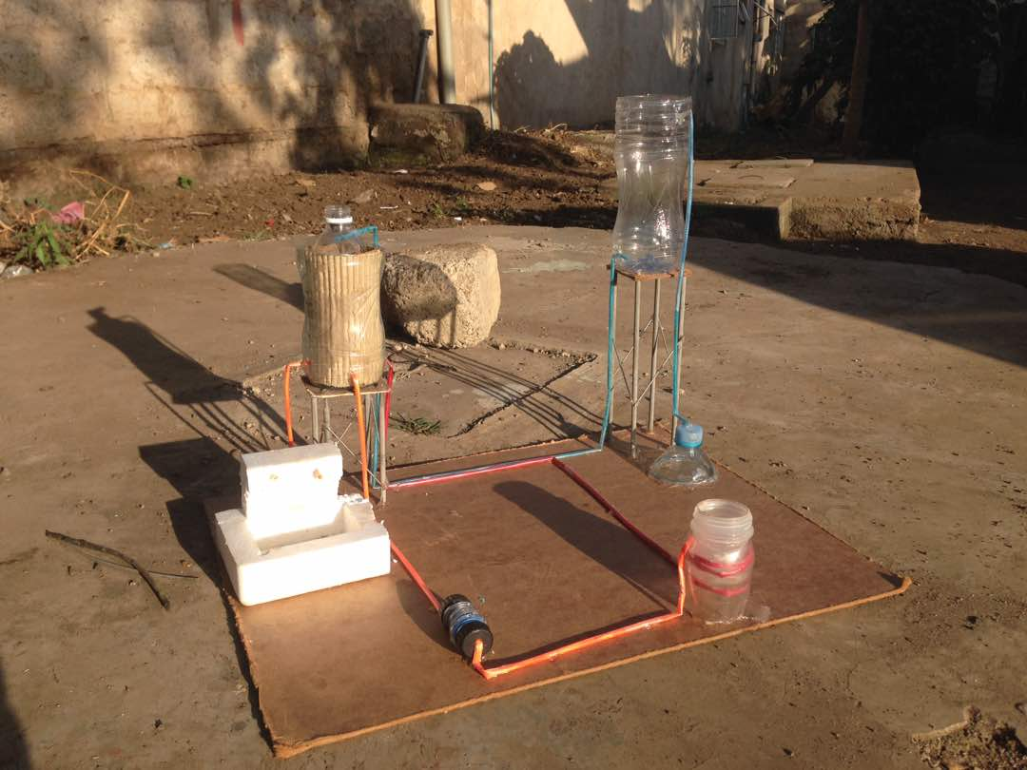
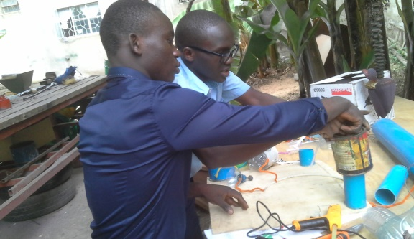
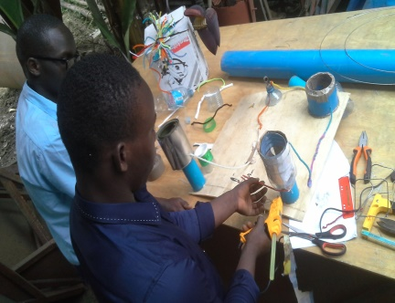
27.
Simple Hot Shower Invention For Large Groups
Edmund Rice Sinon
Lameck Masau and Nadia Kabwe
Abstract:
We; Nadia Kabwe and Lameck Masau are the Young Scientists of Tanzania (YST) students studying at Edmund Rice Sinon Secondary School Arusha. Our project is about simple hot shower invention for large groups. It can fit well in highly crowded areas such as schools, prisons, orphanage centres, hospitals, refugee camps and among others. It involves simple technological skills such as the use of local available cookers, fire woods, pipes, tanks, bouyer, water and water pumps. Its environmental friendly as it reduces air pollution, conserves energy and enhance the eradication of health complications resulted from cold shower as people will now be using HOT SHOWER in a VERY SIMPLE WAY.
It’s our hope that this absolute technological system will help both the local and urban people especially in large groups as mentioned above.
Method:
A pipe from the source eg. WELL through which water will pass is connected to the top positioned collecting tank.
Another outlet pipe is connected at a little bit lower part of the collecting tank so as to easy the out-coming of water by high pressure.
The out-going cold water through the pipe is directed to the top of the other lagged tank. This tank has to be positioned a little bit at a lower position than the collecting tank so as to allow the easy transfer of water by the gravitational pull/force. The bouyer is well placed near the hole receiving water so as to close when the tank is full.
The other pipe is connected beside but at the lower part of this tank. This pipe is responsible for taking water to the coiled pipes around the local vacuumed cooker. NOTE: The process of taking water from the lagged hot water collecting tank to the local cooker is facilitated by presence of a MOTOR which also accelerate the speed of water.
The only simple modification here is to make sure that the local ironed local cooker is set with a vacuum on its walls through which the coiled pipes taking water receive heat by conduction uniformly. The coiling of the pipe passing through the vacuum is meant to allow enough time for the water to get heated by conduction and in large quantity. REMEMBER:This process of heating water occurs while cooking of food,tea etc is going on.
There is another plastic pipe now which take the hot water from the cooker to the lagged hot water collecting tank.
Another hot water outlet pipe is connected from the lower part but not exactly at the base of the tank. This outlet pipe is to take water straight to the hot water taps for use.
Time (Min): For the same fuel quantity | 5 | 10 | 15 | 20 | 25 | 30
Local way: Litres | 4 | 9 | 14 | 17 | 20 | 23
Our Project: Litres | 12 | 26 | 42 | 52 | 61 | 70
Results:
The research we did at Faraja Elders and Children Center and at Njiro CGS as well as around our School in Arusha had shown that many people/students get to spend too much time and energy when it comes to preparation of hot water for shower.This tendency had even led other(students) not to take shower and thus brings unpleasant smell to others when one pass or sit next to him/her. This can be proved by one of the Institutional kitchen worker named Mzee Saidi Laizer from Engosheraton and one teacher (Mr Nkana) whom we spoke with in our project conversation session. Not only him but also our lovely H/Master Br.Kaswahili and Mama Jane(Patricia Prosper) said the same thing and congratulated us for having a big positive thinking towards the well being of our society specifically the Community. The conversation with one of the nurses who wanted her name not to be mentioned commented that if this project become successful, some health complications such as allergy are going to be reduced to a very high extent.
Conclusions:
The observation from the above data shows that our project will be more than three times effective and efficient compared to the use of local ways currently used to get hot shower. In this case, students and other people respectively will have more time to engage in academics and other economic activities as our current National slogan states ”HAPA KAZI TU” and hence less or no more failures and poverty.
From the results above, we suggest that our Simple Hot Shower Invention is the best and emerging technology to be used in crowded areas such as Schools, Prisons, Orphanage centers, hospitals as well as in Refugee camps found both in urban and rural areas.

