Slide 1
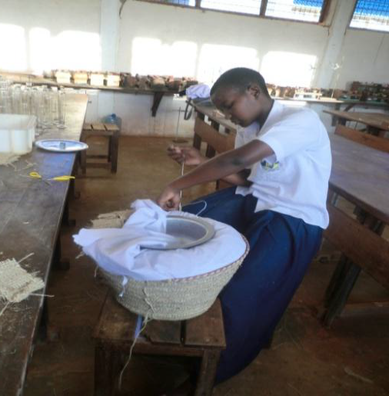
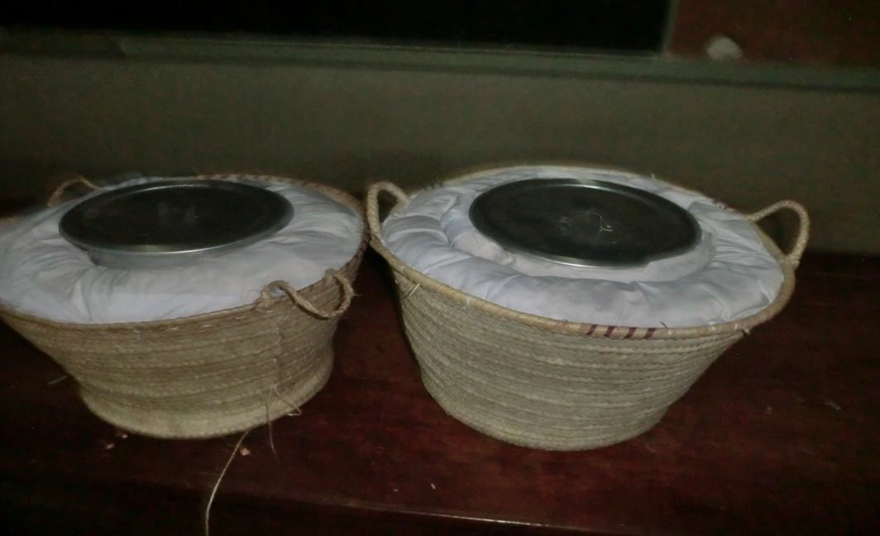
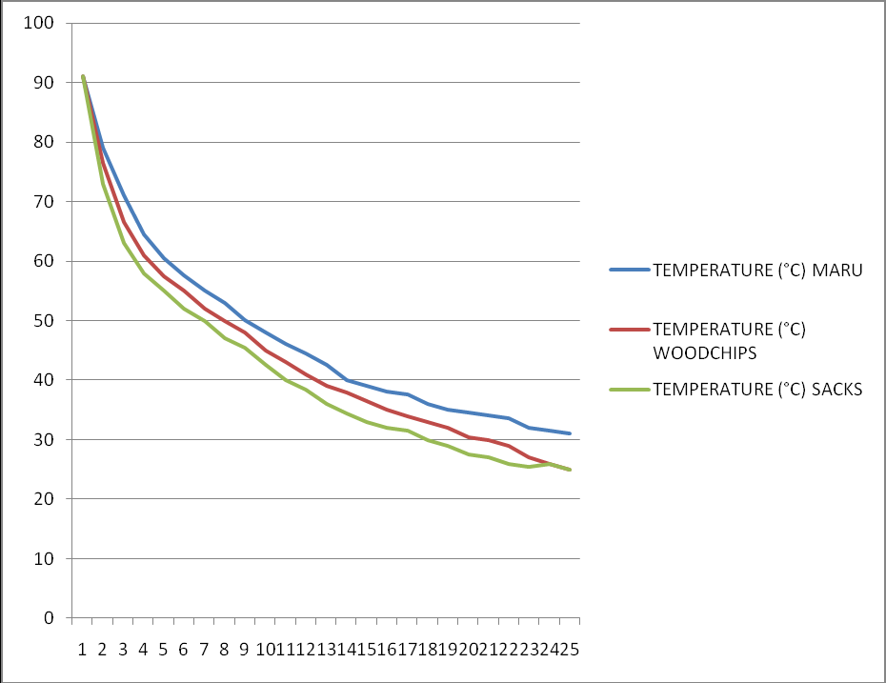
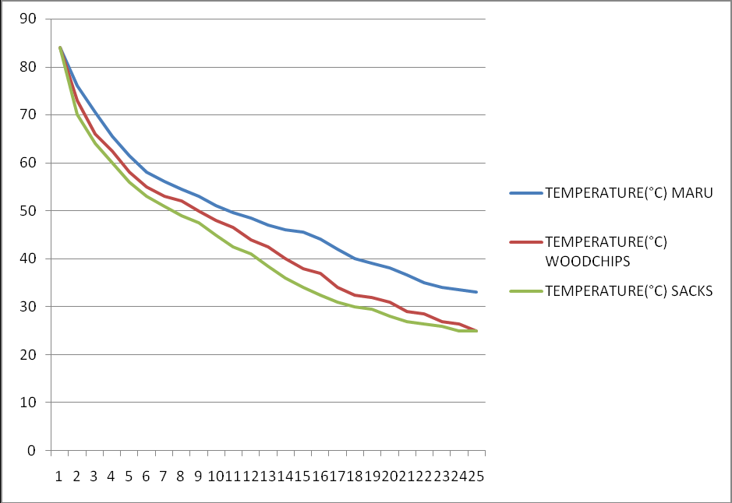
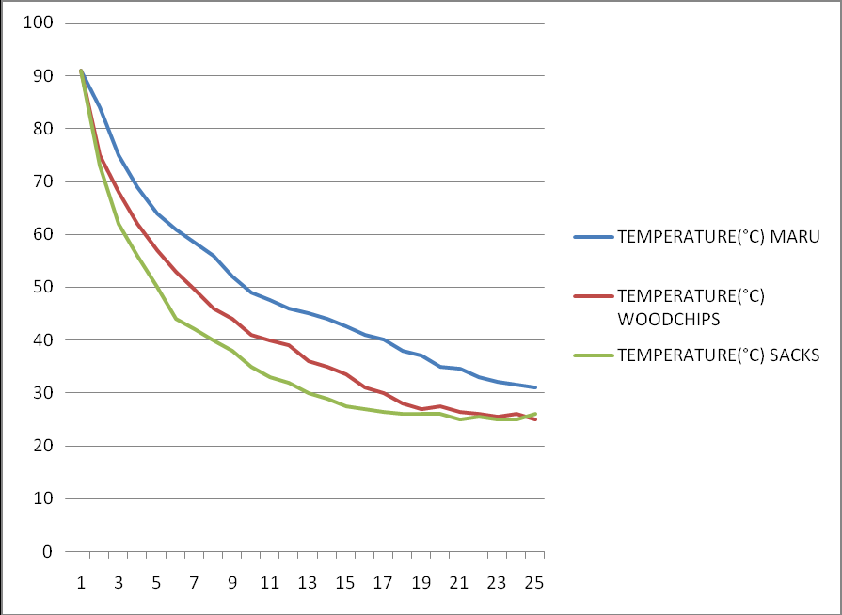
31.
Effectiveness of the Maru Hotpot In Maintaining Heat In Food
Kilakala Secondary School
Mawata Matukuta and Annagrace Malamsha
Abstract:
This project aims at proving the efficiency of Maru leaves and the construction of a Maru hotpot which keeps food hot for a satisfactory number of hours. It will especially enable the school food sellers, mamantilies and food vendors to maintain the food’s hot temperature. This will help to reduce the rate of problems caused by food contamination. The Maru hotpot is cheap hence it can also be afforded by people with poor economic status.
Method:
Maru is a Bantu word meaning banana. This simple Maru hotpot is a combination of easily available materials which provide an alternative method of keeping food hot for a satisfactory number of hours. This hotpot is mainly comprises of dry Maru leaves, a basket, white piece of cloth, a midsized saucepan together with wood chips and sacks which were compared with Maru. Our project aimed at investigating the efficiency of Maru leaves with other mentioned lagging materials. The efficiency of Maru leaves which are bad conductors of heat due to having unique drafts (compartments) which are filled with air. Little heat lost to the surrounding was guaranteed by the stuff in Maru hotpot being the lagging material.
How to construct a Maru hotpot
1. Gather the needed materials, these are; Basket, lagging material (chopped Maru leaves), saucepan with a lid, white piece of cloth, needle and thread
2. Pour and compress enough Maru leaves inside the basket leaving a middle space only fit for the saucepan to be placed.
3. Gently place the white piece of cloth to cover the Maru leaves and sew it against the basket’s top with the saucepan in place.
4. Into the bamboo sieve, put and cover the chopped Maru with the white piece of cloth, sew against the bamboo sieve tightly to keep the Maru in position.
5. Make sure the bamboo sieve fits well on the basket by adjusting the compressed Maru through the piece of cloth.
Results:
The effectiveness of the Maru hotpot is due to the presence of air tightly held by the draft-like structures observed in the internal structure of the Maru leaf. Hence the Maru leaves are used as the lagging materials so as to prevent heat loss from food stored in the Maru hotpot. This is all purely science obtained from the concept of HEAT. Calculations of rate of heat loss can be made to show how slowly heat is lost.
The arrangement of the saucepan and the Maru in the baskets relates to composite series arrangement in thermal conduction. Since each of the material has its own coefficient of thermal conductivity heat will pass through at different amount but the same rate.
T vs time for semi liquid food stored in maru, wood chips and sack hotpot
T vs time for solid food stored in maru, wood chips and sack hotpot
T vs time for liquid food stored in maru, wood chips and sack hotpot
Conclusions:
The findings showed that the air spaces in Maru leaves highly contribute to their characteristic insulating property compared to wood-chips and sacks. This means that little heat from the Maru-hotpot will be lost to the surroundings making it efficient for storing food for a number of hours. It enables food to keep warm without reaching the room temperature for24 hours.
Acknowledgments:
We are indebted to the school administration for funding this project as well as supporting us.
We also wish to thank Mr. Mtambo our physics teacher for all his encouragement, constructive ideas, special and incredible contributions in the entire process of this project.
We would also like to express our gratitude to our beloved YST coordinator in our school Mr. Godfrey Kavenuke for his invaluable support during the project.

