Slide 1
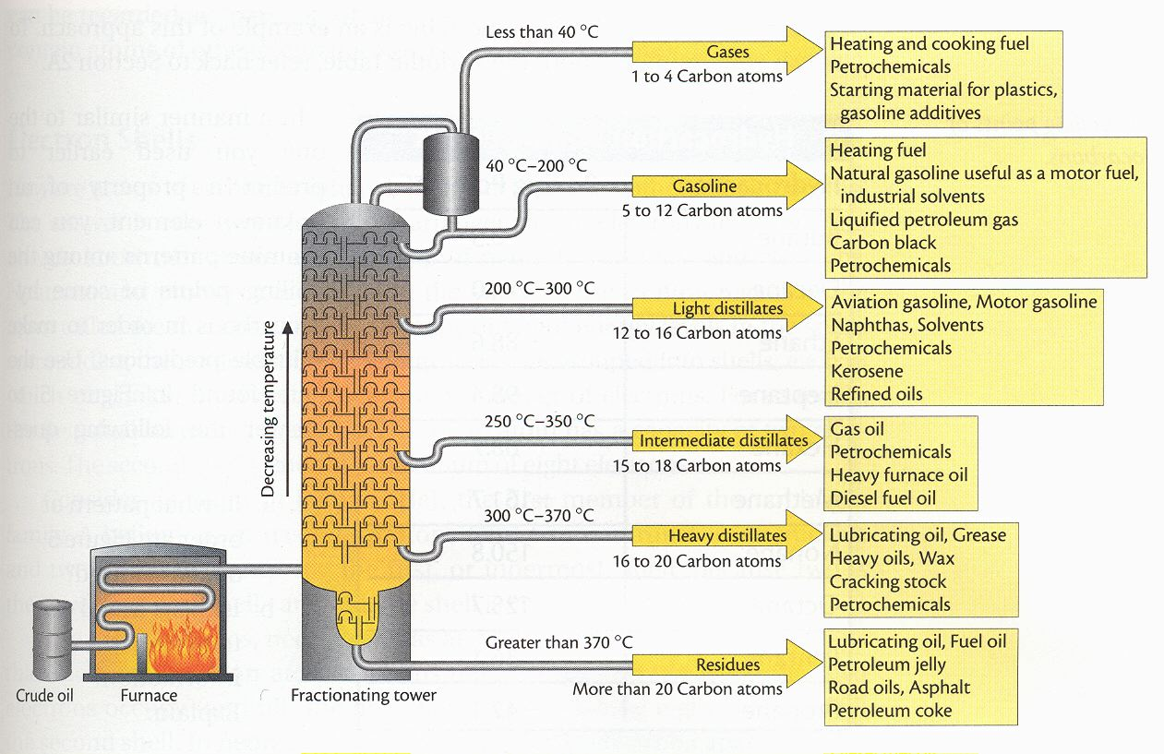
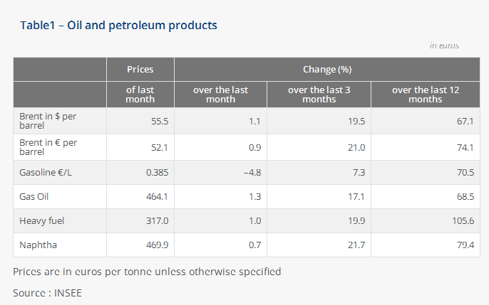
40.
Can Oil Refining Products Reach The Required Destination?
Arusha Modern
Swaumu Makongoro and Raynarious Zakaria
Abstract:
In this particular study researchers are intending to find out if the application of oil refining products can reach the required destination for industrial economy in Tanzania. The objective of the study was to assess on how and to what extent the application of oil refining products can enhance industrial economy in Tanzania.
Related information concerning our study was put into consideration. The descriptive research design was used for collection of data from the variables with the nature of producing data, required for quantitative and qualitative analysis and to allow simultaneous description of views, perceptions and beliefs at any single point in time.
Our sample included Arusha modern teachers, filling station managers, a worker from General Tires Limited and a TRA human resource officer.
The information obtained is a true act towards solving the problems hindering industrial economy in Tanzania, it is our hope that our study will result into a positive impact towards industrializing Tanzania.
Method:
The study collected both primary and secondary data. According to Creswell (2006), no single technique or instrument may be considered adequate in itself in collecting valid and reliable data. Therefore, to obtain adequate and reliable information for the topic under study, different techniques were adopted. Through triangulation procedure, the researcher used various tools of data collection which include questionnaires, Interviews and documentary review. This choice of use multiple ways is supported by Cohen and Marrison (2000) who noted that no single method can act in isolation since any bias can distort the whole picture of reality the researcher is investigating.
A simplified diagram showing oil refining process of crude oil and the end products
Results:
From the data collected among 10 teachers that were included in our research most teachers had
either 1 or 2 automobiles of which all automobiles run on petroleum, which is attributed to the
fact that the cars used are miniatures and convertibles which have engines that rely on petroleum
The study concluded that total, meru, bonjour filling stations sell 174-1000liters of diesel,600-2000liters of petroleum and 150-300liters of kerosene daily, of which for diesel is sold at 1958tshs per liter, petroleum is sold at 2098tshs per liter and kerosene is sold at 1890tshs per liter where diesel and petroleum face a taxation of 40tshs for every liter sold, which is collected through the modern electronic method by the Tanzanian Revenue Authority(TRA) .The rate at which petroleum is sold is greater compared to that of diesel because most civilian cars are small automobiles which run on petroleum and the cars that run on diesel are mostly heavy work cars such as tractors.
 |  | GENERAL TIRE COWORKERS |  | TEACHERS |  | FILLING STATION MANAGER
Sex |  | Frequency | Percentage | Frequency | Percentage | Frequency | Percentage
Male |  | 1 | 100 | 7 | 70 | 3 | 75
Female |  | 0 | 0 | 3 | 30 | 2 | 25
Total |  | 1 | 100 | 10 | 100 | 5 | 100
Conclusions:
Our study has proven that the application of oil refining products can reach the required destination for industrial economy in Tanzania due to the fact that oil refining products may effectively be a good source of capital, raw-materials, power, influence agriculture, advanced transport and communication all of which are the major factors for industrial economy in Tanzania.
Furthermore, our study has proven that oil refining products are very beneficial to industrial uses since they are used as raw materials for manufacturing plastic materials, insecticides, pesticides, dyes and more beneficial products. Also oil refining products can be used as sources of power in running industries and in lubrication of machines.
Recommendations:
Our project recommends the following
Emphasis on more experts from oil engineering should be considered
The government should be strategic on expanding areas for investment
Precautions in extracting , transporting ,storing and refining oil should be considered
The government and non-governmental organizations should aid in the re-functioning on the industries that have declined

