Slide 1
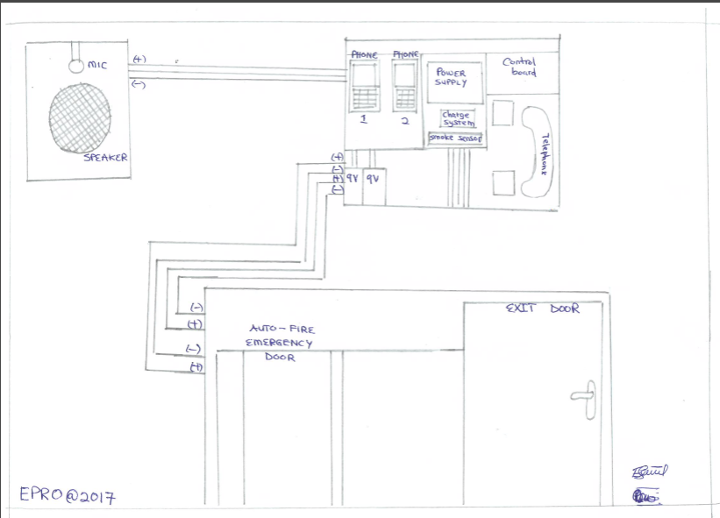
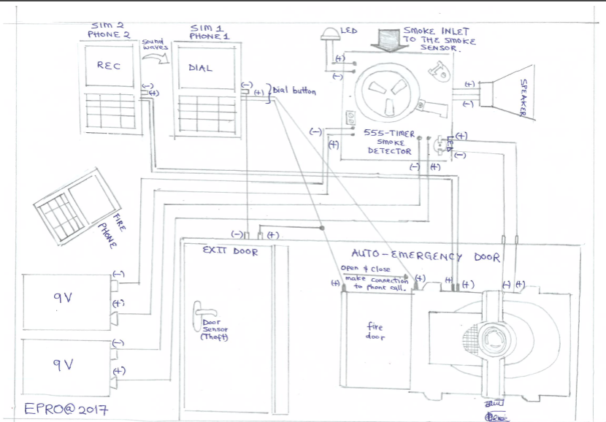
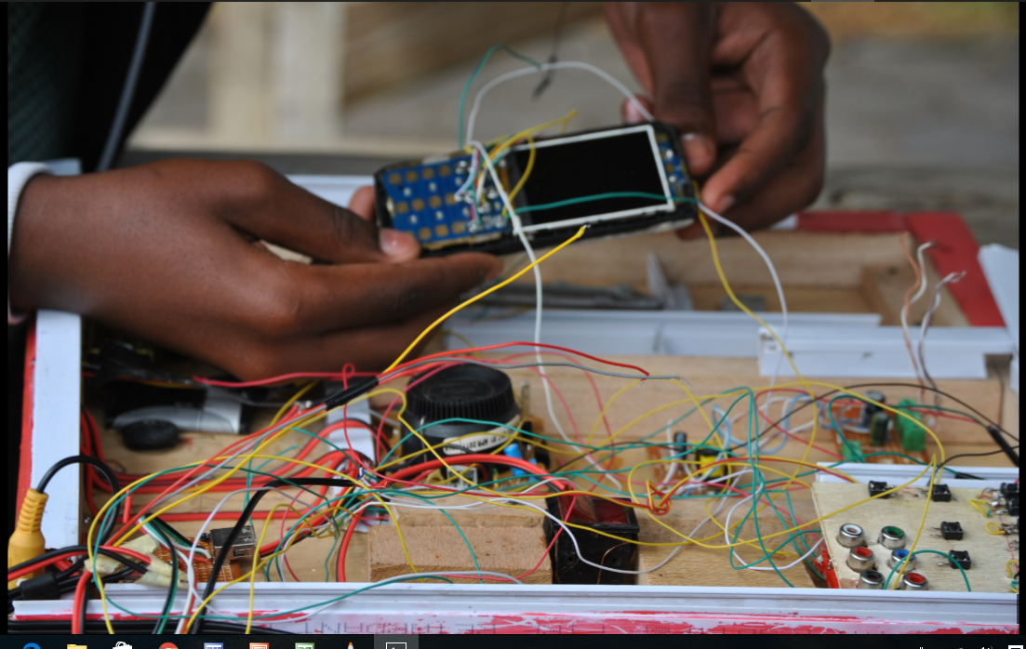
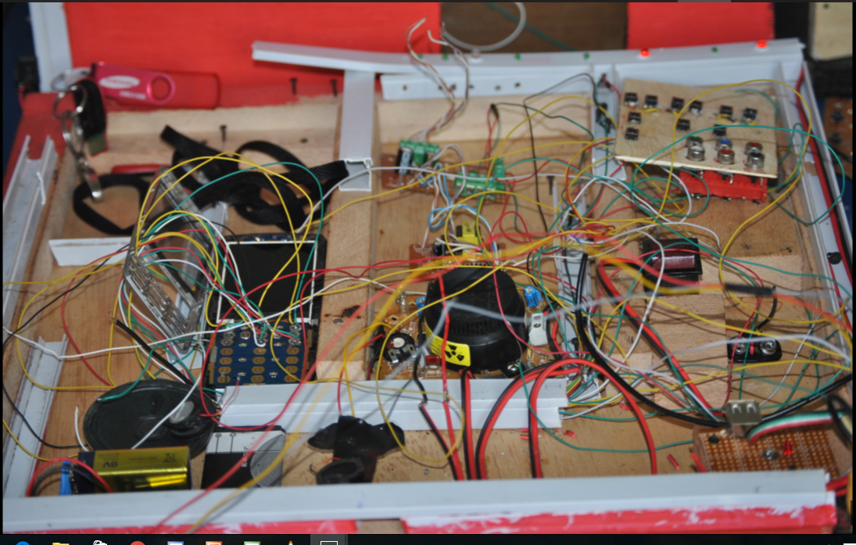
73.
The Use of the Mobile Network as a Fire Alert System
St Jude Secondary School
Prosper Gasper and Erick Simon
Abstract:
We aimed at improving people’s security against theft and fire. The main benefit of our project currently; it’s a part of thing which emphasizes the growth of technology to Tanzania and neighboring countries.
We applied electronic skills to alleviate the problems facing our societies; we used mobile phone smoke sensors and other instruments to make up our project possible to work effectively.
Method:
We targeted in innovating the use of mobile network to alert about fire system attached with theft alert.
We used the electronic devices and knowledge of phone making skills that we had to make something more important rather than only using phone for message and calls we therefore used phone in another way to solve problems of fire and theft in our lovely country Tanzania and society at large.
We began with smoke sensor which plays a role of distributing signals to the phone after fire occurrence and when the signals enter the phone, the phone converts it immediately and makes a call to the fire fighters plus the owner of the house also the smoke detector send signal to the emergence door automatically.
MOBILE PHONES
This is where the phones that are among the component of our project it is used to allow communication to the fire fighters and the user of the system and receiving signals from smoke detector its make a call automatically to make aware to fire fighters that there is fire incidents an a place
Note that:
Theft cases is when an intruder touches the door handle, the phone in the system automatically dials and when the intruder succeed to get in, the phone will give out response to the owner of our system directly and report about someone entering in the house (note that many people are asking if our system is programmed the truth is our system is not programmed and its function as programmed because everything works automatically)
Results:
Generally, we had a result from the outcome of our project whereas this was after our installation that we did to one among our staff in which the system operated well. Our final comparison from our system from the existing system is we had to find out existing system which resembles to our system. We found out that Benson and company can come up with systems like ours, but our new innovation is our system after fire occurrence the smoke sensor detects the smoke and open the emergency door automatically therefore the phone available in the system makes a call to fire fighters and the owner of the system who is far away from his or her premises. So our difference from Benson and company it’s their systems their excellent in producing an alert to the user with no measure to make a communication process to fire fighters. Also good example is their emergency doors just have some alert but the doors lock themselves after fire. Which lead to difficulties for the entrance of fire fighters and exit of people who are in the building? Therefore our emergence door opens itself automatically after fire occurrence. We ended up using mobile network to alert people about fire and theft occurrence.
Conclusions:
We developed a simple system that is capable of detecting smoke and alert the user about the presence of fire in the house or any building, this system can call fire fighter as well as the owner the house but also it can open the door automatically that will allow free exit of the people from inside the house and save their life and their properties of which if you can compare with the existing system they only detect presence of smoke and give signal like alarm sound and red light but can not open the emergence door automatically and there is no accessibility of mobile communication.

